Slide 1
Blockchain Variants
Blockchain Technology

Slide 2
Blockchain Variants
Public
Private
Hybrid
Consortium/Federated
Permissioned

Slide 3
Why we need different blockchains?
The most basic need or application of a blockchain is to carry out transactions or exchange of information through a secure network.
The way people use blockchain and distributed ledger technology or network vary from case to case
Cryptocurrencies should have public access so that they can be used by mainstream users
In comparison, a banks’s blockchain should be closed for outside access
Cant have single blockchain for everything!
Questions: Why there are so many search engines and browsers when only one can serve the purpose?

Slide 4
Public Blockchain
A public blockchain is a non-restrictive, permission-less distributed ledger system
Anyone who has access to the internet can sign in on a blockchain platform to become an authorized node and be a part of the blockchain network
A node or user which is a part of the public blockchain is authorized to access current and past records, verify transactions or do proof-of-work for an incoming block, and do mining
The most basic use of public blockchains is for mining and exchanging cryptocurrencies e.g. Bitcoin, Ethereum, Litecoin, etc

Slide 5
Benefits of Public Blockchain: Trustable
Two nodes or participants do not need to worry about the authenticity of the other
Nodes don’t need to personally know or trust the other nodes as the process of proof-of-work makes sure there can be no fraud in transactions
Users can trust public blockchains blindly without feeling the needing to trust individual nodes

Slide 6
Benefits of Public Blockchain: Secure
There can be as many participants or nodes in a public network which makes it a secure network.
The larger the network, greater the distribution of records and harder it is for hackers to hack the entire network.
Every node will do verification of transactions and proof-of-work which makes every transaction and block legitimate.
Due to these practices and thoughtful cryptogenic encrypting methods, a public blockchain is much safer than the private one

Slide 7
Benefits of Public Blockchain: Open and Transparent
Public blockchain is open and the data is transparent to all the participant nodes
A copy of the blockchain records or digital ledger is available at every authorized node
This makes the entire blockchain system completely open and transparent
No one shows a fake transaction or hides an existing one as every node has an updated copy of the database at any given point of time

Slide 8
Drawbacks of Public Blockchain: Lower TPS
The rate of transactions per second in a public blockchain is very low
This is because it is a huge network with a lot of nodes and for every node to verify a transaction and do proof-of-work is time-consuming
This is why public blockchains like Bitcoin can process only 7 transactions per second or Ethereum network has a rate of 15 TPS
On the other hand, a private network such as Visa has a rate of 24,000 TPS indicating a huge difference in speed of transaction processing and execution

Slide 9
Drawbacks of Public Blockchain: Scalability Issues
Public blockchain have a slow rate of processing and completing transactions, this causes issues in scalability as well.
The more we try to increase the size of the network, the slower it will get
However, solutions like Bitcoin’s Lightning Network helps in overcoming this problem. It maintains a rate of the transaction as we increase the size of the network.

Slide 10
Drawbacks of Public Blockchain: High Energy Consumption
The process of proof-of-work is highly energy consuming as it needs specialized systems (hardware components) to run a special algorithm
It is a matter of concern from both an environmental and economical standpoint.
For example, the Bitcoin’s proof-of-work mechanism is so costly that it consumes as much energy as the country of Ireland!

Slide 11
Private Blockchain
A private blockchain is a restrictive or permission blockchain operative only in a closed network
Private blockchains are usually used within an organization or enterprises where only selected members are participants of a blockchain network
The level of security, authorizations, permissions, accessibility is in the hands of the controlling organization
Private blockchain networks are deployed for voting, supply chain management, digital identity, asset ownership, etc.

Slide 12
Benefits of Private Blockchain: Speed
Private blockchains’ transactions occur at greater speed as compared to public blockchains
That means the transactions per second (TPS) rate is higher in the case of private blockchains
This is because there is a limited number of nodes in a private network as opposed to a public network
This fastens the consensus or verification process of a transaction by all the nodes in a network
Private blockchains can facilitate the transactions at a rate of up to thousands or hundred thousand TPS at a time

Slide 13
Benefits of Private Blockchain: Scalability
Private blockchains are pretty scalable if we choose the right size of private blockchain as per needs
For instance, if there is an organization that needs a blockchain of only 20 nodes, they can easily deploy one. Then after expansion, if they need to add more nodes, they can easily do so
This makes private blockchains very scalable as it gives an organization the flexibility to increase or decrease the size of their network without much effort

Slide 14
Drawbacks of Private Blockchain: Needs Trust-building
As far as a public blockchain is concerned, it is like an open book or as we call it, an open ledger. This ensures the security and legitimacy of every user
Whereas, in a private network, there are limited participants in a restricted network. Especially within an organization, where colleagues know each other
They need to build trust to transmit confidential information within a network

Slide 15
Drawbacks of Private Blockchain: Lower Security
As a private blockchain network has lesser number of nodes or participants, it runs a higher risk of a security breach.
If anyone of the nodes gains access to the central management system, it can gain access to all the nodes in the network
This makes it easier for a node to hack the entire private blockchain and misuse the information

Slide 16
Drawbacks of Private Blockchain: Centralized
Private blockchains are restricted, that is they need a central Identity and Access Management (IAM) system for functioning properly
This system has all the monitoring and administrative rights. It gives permissions to add a new node in the network or decide the level of access they get for the information stored in the blockchain
This whole system contradicts the idea of decentralization which is one of the pillars of blockchain technology

Slide 17
Hybrid Blockchain
The combination of public and private blockchain, used by an individual entity that reaps the benefits of both approaches
Users can control who gets access to which data stored in the blockchain
Only a selected section of data or records from the blockchain can be allowed to go public keeping the rest as confidential in the private network
Suitable for a company with top to bottom hierarchy
  Top management is allowed to access both public and private parts of the blockchain
  Rest of the employees can only access public part of the blockchain

Slide 18
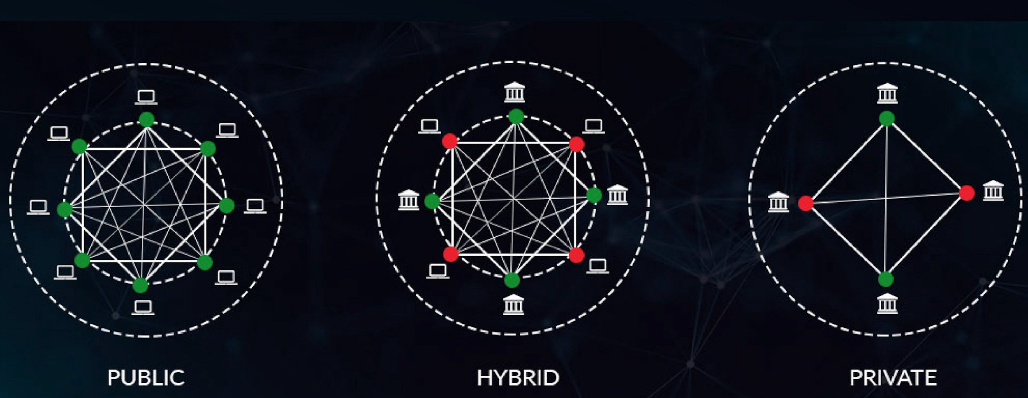
Public vs. Private vs. Hybrid

Slide 19
Consortium Blockchain
A consortium blockchain is a semi-decentralized type where more than one organization manages a blockchain network
More than one organizations can act as a node in this type of blockchain and exchange information or do mining
Only a certain number of nodes defined in advance have the authority to validate transactions
Consortium blockchains are typically used by banks, government organizations, etc.

Slide 20
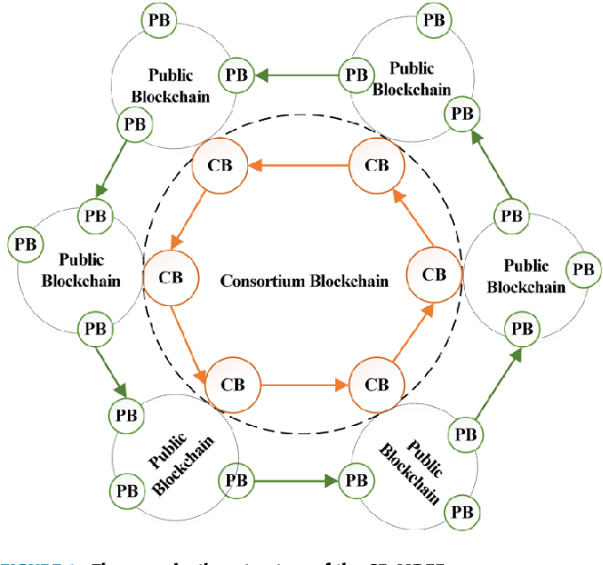

Slide 21
Permissioned Blockchain
Permissioned blockchains are blockchain networks that require access to be part of it
In these blockchain types, a control layer runs on top of the blockchain that governs the actions performed by the allowed participants
Blockchains are built such that they grant special permissions to each participant for specific functions to be performed—like read, access and write information on the blockchains

Slide 22
Benefits of Permissioned Blockchain: Efficient Performance
Permissioned blockchains offer better performance than private blockchains because of the limited number of nodes on the platform
This removes the unnecessary computations required to reach consensus on the network, improving the overall performance
On top of that, permissioned networks have their own pre-determined nodes for validating a transaction

Slide 23
Benefits of Permissioned Blockchain: Proper Governance Structure
Permissioned networks come with an appropriate structure of governance, this means that they are organized
Administrators require less time to update the rules over the network, which is considerably faster when compared to public blockchains
Public blockchain network suffers from the consensus problem as not all nodes work together to get the new update implemented. These nodes might place their self-interest above the needs of the blockchain, which, in return, means slower updates to the whole network.
In comparison, permissioned blockchain doesn’t have the problem, as the nodes work together to move the updates faster.

Slide 24
Benefits of Permissioned Blockchain: Decentralized
Permissioned networks make proper use of blockchain, including utilizing its decentralized nature for data storage

Slide 25
Benefits of Permissioned Blockchain: Cost Effective
Permissioned blockchains are more cost-effective because the validation process is limited to few nodes so rest of the nodes don't have to perform proof of work everytime

Slide 26
Drawbacks of Permissioned Blockchain: Compromised Security
The security of a permissioned network is as good as the member’s integrity
This means that a small section of a permissioned system can work together to modify the data stored within the network, resulting in compromising the integrity of the network
To resolve it, the system should have proper permissions set so those bad actors cannot merge together to cause the desired effect

Slide 27
Drawbacks of Permissioned Blockchain: Control, Censorship and Regulation
The regulations bring censorship to the network, where the authority can restrict a transaction or control it from happening
These are a threat to any business or organization who is using the permissioned network
This approach also stops the permissioned network from making the most out of the whole blockchain ecosystem

Slide 28
Permissioned vs. Permissionless Blockchain
Category | Permissioned | Permissionless
Speed | Faster | Slower
Privacy | Private Membership | Transparent and open - Anyone can become a member
Ownership | Managed by predefined group of nodes | Public ownership - No one owns the network
Decentralization Nature | Partially decentralized | Truly decentralized
Cost | Cost effective | Not-so cost effective
Security | Less secure | More secure

Slide 29
Reference Book
Bitcoin and Cryptocurrency Technologies
Authors: Arvind Narayanan, Joseph Bonneau, Edward Felten, Andrew Miller, Steven Goldfeder
Publisher: Princeton University Press

